Slide 1
STAYING STRONG AFTER CANCER LIVESTRONG at the YMCA ATTH Create Your Best Life

Slide 2
“Exercise can’t make your cancer go away, but it certainly can help you look and feel better and have a better perspective and outlook on life.”
– Anna Schwartz, author of Cancer Fitness

Slide 3
General Physical Activity Recommendations For Cancer Survivors- During & After Treatment
Avoid inactivity​
Continue normal daily activities and exercise as much as possible during and after treatment​
Return to normal activities as soon as possible​
Be physically active as your abilities and conditions allow​
Some exercise is better than none!

Slide 4
Exercise Recommendations- Cardiovascular Exercise
Engage in at least 150 minutes of moderate-intensity physical activity throughout the week, or at least 75 minutes of vigorous-intensity physical activity throughout the week, or an equivalent combination ​
Do moderately intense cardiovascular exercise 30 minutes/day, 5 days/week​
OR do vigorously intense cardiovascular exercise 25 minutes/day, 3 days/week​
Note: Start low and go slow, gradually increasing the number of minutes and days

Slide 5
Exercise Recommendations- Strength Training
Perform 8-10 exercises major muscle groups​
8-12 repetitions of each exercise​
2 days/week on nonconsecutive days

Slide 6
Exercise Recommendations- Flexibility
Stretch major muscle groups used on days that other exercise is performed (strength or cardio) ​
Stretch “warm” muscles​
Hold for 15-30 seconds

Slide 7
Exercise Recommendations- Balance
Exercises that strengthen muscles that keep you upright and steady- including legs and core​
Can be incorporated with strength training
Reduces the risk of falling​
Better balance gives us the ability to move- or remain in a position- without falling ​
3 or more days/week​
Reduce side effect severity
Mindfulness-Based exercise classes typically incorporate flexibility, balance, and strength.

Slide 8
Exercise Considerations
Clearance from physician​
Under the direction of someone that is trained to work with cancer survivors
Maintain proper form
Reduce side effect severity
Start small​
Progress the exercises slowly​
Frequency, Intensity, Time​
STOP doing anything that causes pain

Slide 9
Long Term Benefits of Exercise
Done regularly, exercise has been shown to…
Reduce chances of cancer recurrence, extends survival & improves quality of life
Improves heart & lung capacity
Reduce insomnia & depression
Boost self-esteem
Reduce high blood pressure & cholesterol
Helps prevent other health conditions such as:
Diabetes, heart disease, and strokes
Furthermore, being inactive is a risk factor for nearly all of the above mentioned, it’s not only important to prevent reoccurrence of cancer but all diseases!

Slide 10
What is LIVESTRONG at the YMCA?
LIVESTRONG at the YMCA is an evidence-based small group exercise program designed to improve endurance, strength, flexibility, balance, and overall quality of life.
Small groups meet twice a week for 12 weeks and workouts are designed to accommodate participants of varying fitness levels. Classes are 1 hour and 15 minutes long
Small groups are made up of 8-12 cancer survivors and 2 LIVESTRONG at the YMCA instructors.

Slide 11
LIVESTRONG at the YMCA
Components of each class include:
5-25 minutes of cardiovascular exercise
5-25 minutes of strength training
5-10 minutes of balance work
5-10 minutes of stretching
Social Interaction with other cancer survivors
Offered at no cost to cancer survivors and also includes a complimentary YMCA household membership.
Once they feel confident, participants are encouraged to work out on their own or attend group exercise classes at the YMCA in addition to the 2 group workouts per week. Virtual Y classes are also available to members.
Notes:
We offer this program at NO COST to the participant because we feel that ALL cancer survivors should have access to this program, without creating any additional financial burden.
LIVESTRONG at the YMCA is supported by the YMCA’s Strong Communities Campaign and when available, grant funding.

Slide 12
LIVESTRONG at the YMCA Program Goals
Primary Goals
Enhance muscular strength and endurance
Increase cardiovascular endurance
Improve flexibility
Restore balance
Secondary Goals
Reduce side effect severity
Improve energy
Improve body image & self esteem
Provide social interaction and peer support
Notes:
Great friendships are formed during this program, as participants can relate to their fellow cancer survivors. They can talk about chemo brain, complain about neuropathy, celebrate their survivorship or support one another they hear bad news that their cancer is back. Sometimes these friendships last years past the end of the 12 weeks.

Slide 13
LIVESTRONG at the YMCA Program Goals
Long Term Goals
Participants are provided with the knowledge, tools, and guidance to continue exercising on their own after the 12-week program has ended
Introduce participants to a variety of ways to exercise so that they find something they enjoy and are therefore more likely to do after the program ends
Introduce participants to classes that they can continue to attend
Notes:
The instructors introduce many exercise options over the course of the 12 weeks, as well as Group Exercise classes, with the hopes that each participant will find something that they enjoy and feel confident in continuing once the program ends.

Slide 14
LIVESTRONG at the YMCA Instructor Qualifications
CPR/AED certified
Nationally recognized Personal Training certification OR Group Exercise Instructor certification
Online Course: Working with Cancer Survivors
16 hour in-person instructor training
1 hour Lymphedema webinar

Slide 15
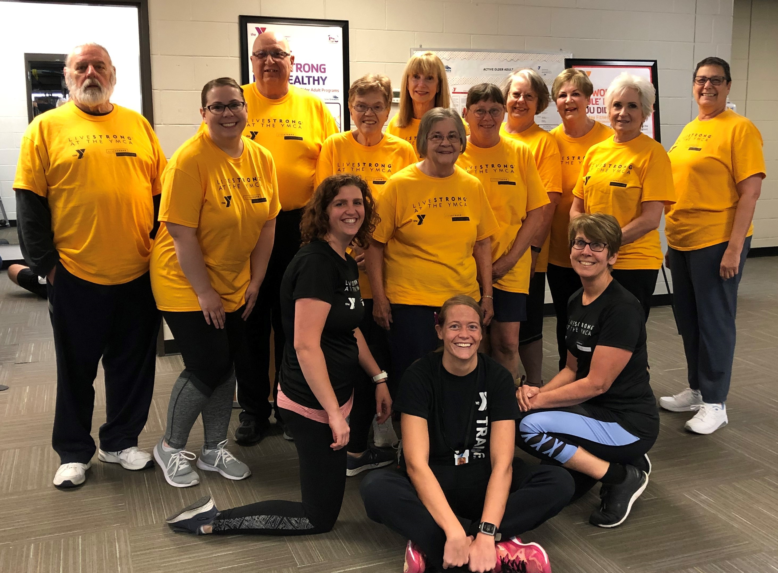
LIVESTRONG at the YMCA Participant Criteria
Cancer survivor- during or post treatment
18 year of age and older
Strong personal desire and commitment to attend all 12 weeks
Medical Clearance from your doctor
Physically able to participate in at least most activities
Willingness to fill out the required forms
Notes:
Survivors can participate in this program while actively going through treatment, or once treatment is over. They are even eligible years later

Slide 16
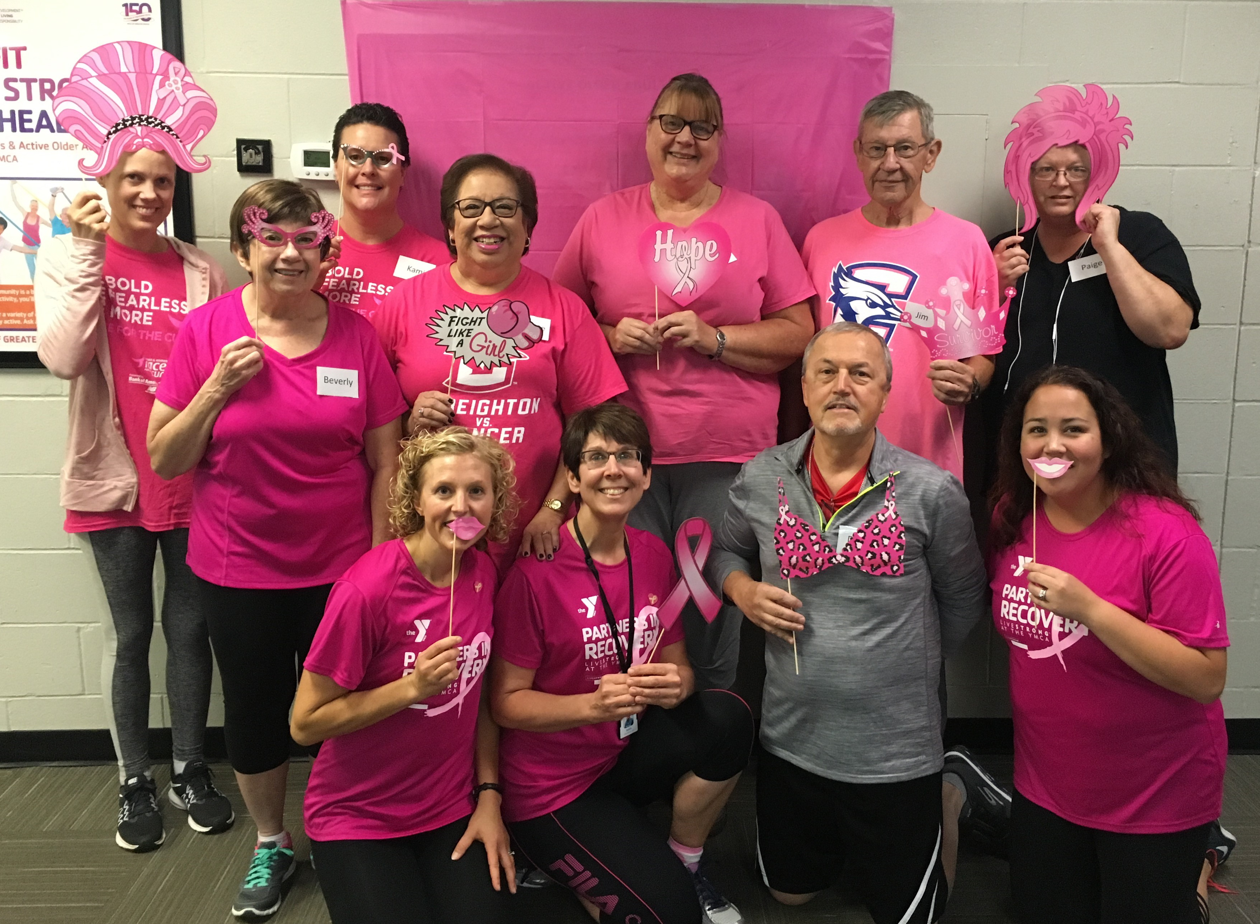
What a few participants had to say about the program….
“(This was) a rewarding program that helped me gain energy back into my life. I’m able to be a better husband and better father since I have more energy. Its been a joy to bring more energy home to enjoy my time with family.”
”I really struggled with my diagnosis of cancer. This experience is the first time I have felt like I could take control of my life back. I was always so happy at the end of each session. Members of the group- as well as instructors- were so kind, positive, encouraging, and supportive.”

Slide 17
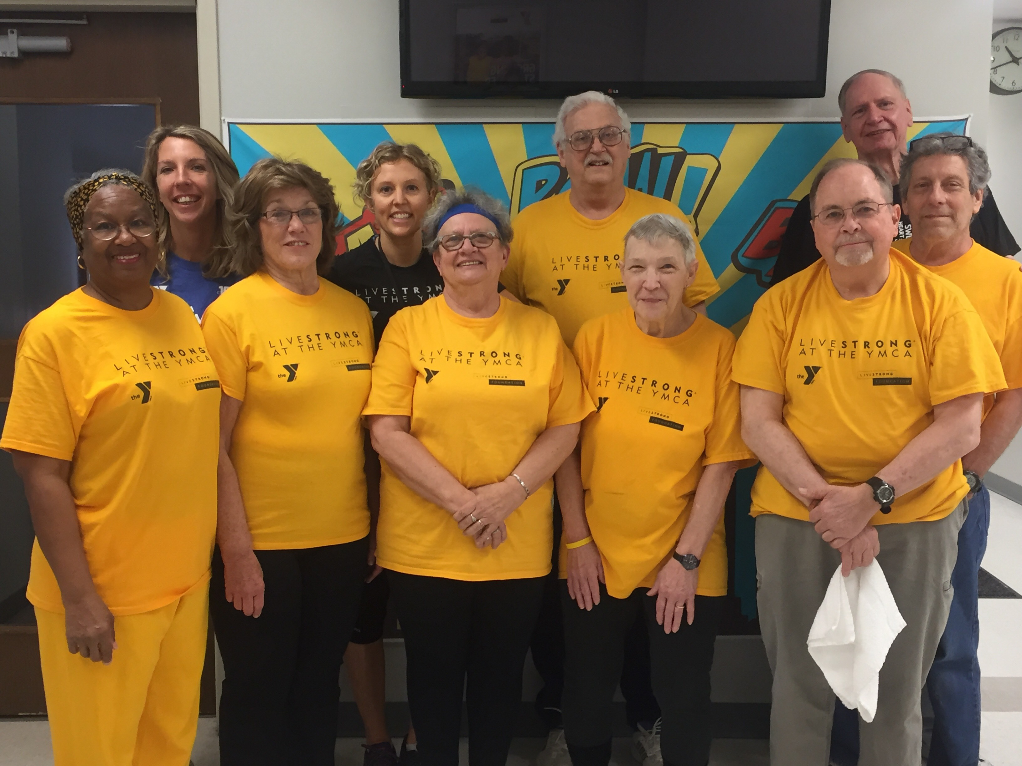
”(This program) has greatly benefited me. I have tried things I wouldn’t have tried on my own. Everything helped with my goal to make exercise a part of my life. As a younger cancer survivor, exercise will always be a part of my life due to this program.
“I loved being with other cancer survivors that were all on this journey together. I would highly recommend this program. “
“The best thing I have done since my cancer diagnosis!”

Slide 18
LIVESTRONG at the YMCA Participating Locations
Classes will begin in February at these locations:
Charles E Lakin YMCA (Council Bluffs)
Gretna Crossing YMCA
Maple Street YMCA (75th & Maple)
Southwest YMCA (132nd & Center)
Armbrust YMCA (168th & Q)
Westview YMCA (156th & Ida)
https://metroymca.org/wellness-programs/livestrong-at-the-ymca

Slide 19
Questions?
My contact information:
Amy Roux
aroux@metroymca.org
Cell 402-616-2177

