Slide 1
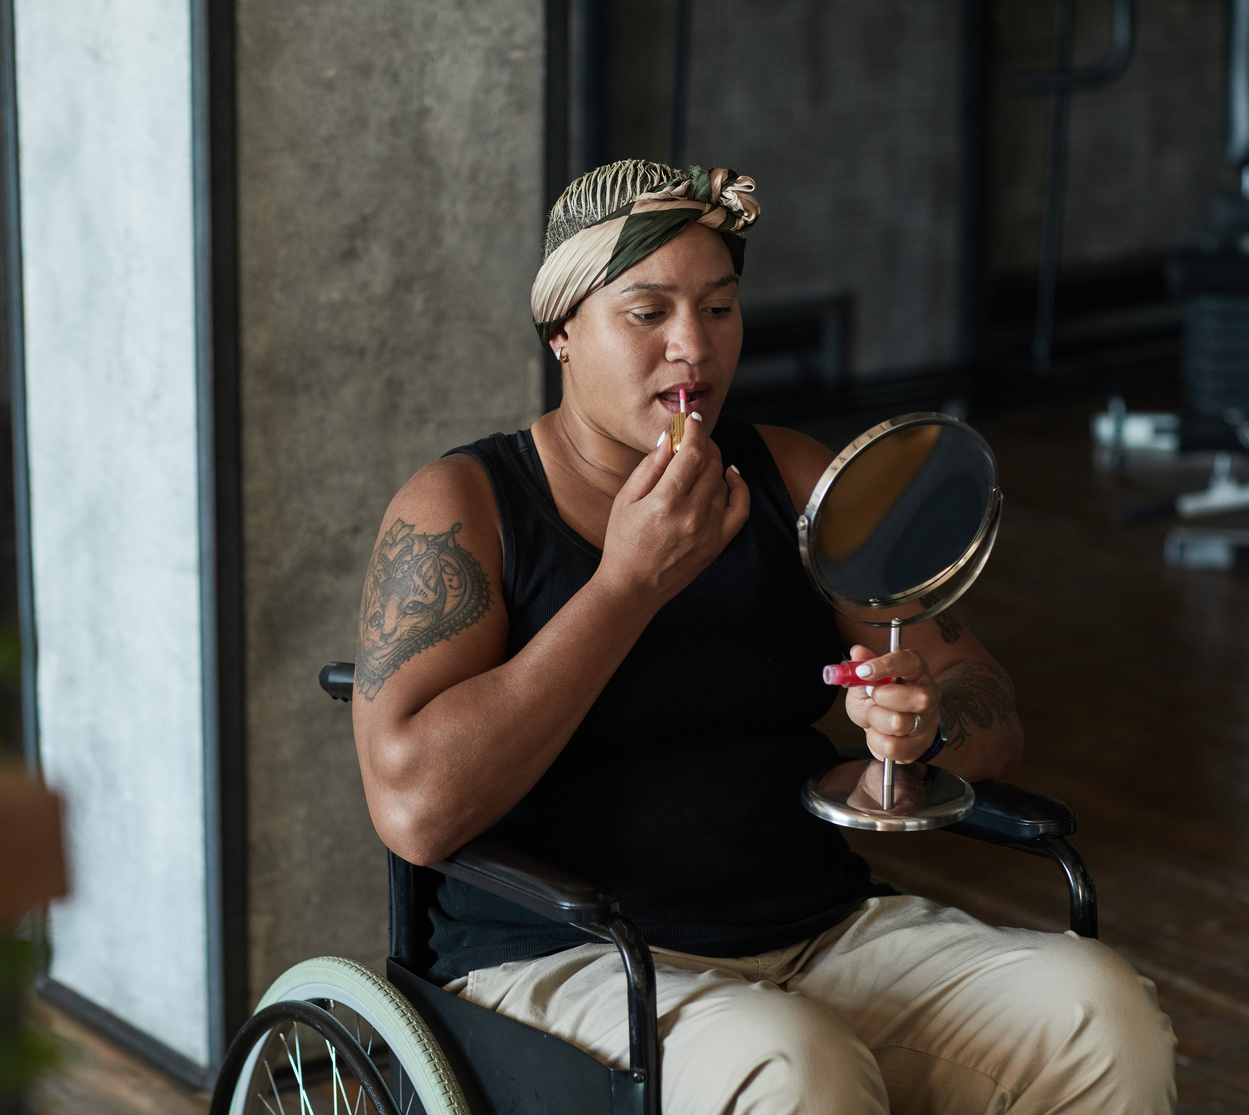
Help! I don’t recognize the person in the mirror!
Stephanie Koraleski,, Darci Zauha, Theresa Bradley

Slide 2
Cancer changes your body
Surgeries, Chemo, radiation, drugs lead to:
Hair loss
Radiation burns
Pallor
Weight loss or gain
Skin rashes, dryness, itching, redness

Slide 3
Cancer can change your appearance
Notes:
Scars or losses or changes in your body
Loss of hair on your head, body and eyebrows and lashes
“Chemo curls,” uneven growth, or different texture or color when hair grows back
Changes in skin tone or texture
Changes in your nails
Weight gain or loss.
Dry skin or rashes, itchiness. Sometimes some people see changes in skin color, lightening or darkening (MD Anderson, 2017, Cancerwise). Moisturize, make sure you apply sunscreen because some txs make you more sun sensitive. Radiotherapy can change the color of your skin, make it red or itchy, dark skin may become darker

Slide 4
Self Image Before vs. After
Powerful
In control
Competent
Attractive
Strong
Independent
Powerless
Out of control
Incompetent
Maimed, disfigured
Weak
Dependent
This Photo by Unknown Author is licensed under CC BY-SA
Notes:
If you are distressed, you’re normal. 56% of Patients say hair loss was the worst side effect of chemo; 72% said it affects their social life. (Saraswat et al, 2019). Others say it’s 3rd worst after Nausea and vomiting. Feel it’s a negative impact on their body image and sense of self.

Slide 5
First, LOVE YOURSELF
Beating yourself up only makes you depressed. You deserve honor and praise for the hard work you’ve done and encouragement with each step forward.
Notes:
If you have every been through labor, you may identify with this picture. Most moms want pix of their newborns, but they don’t want to have a picture of themselves taken right then.. Why? Because they don’t look great.. They’ve been working through hours, the makeup is smeared, they’re sweaty and their hair is messy. And they still have the big stomach! That’s because they just went through some of the hardest work a woman can do. But do you hate yourself? Probably not, because you’re giving your body credit for what it did. (Or you might have a husband or family member who returned from military service, maybe with a scars or without a limb. Do you hate them? No, you are just so, so glad they returned from the war.). Cancer is much like that. Your body has been working it’s hardest to combat the cancer and it’s had help from chemo, radiation, surgery and drugs which have been really hard to take. There’s work to be done, but first, love yourself and thank your body for what it’s done and continues to do to make save your life and let you live well.

Slide 6
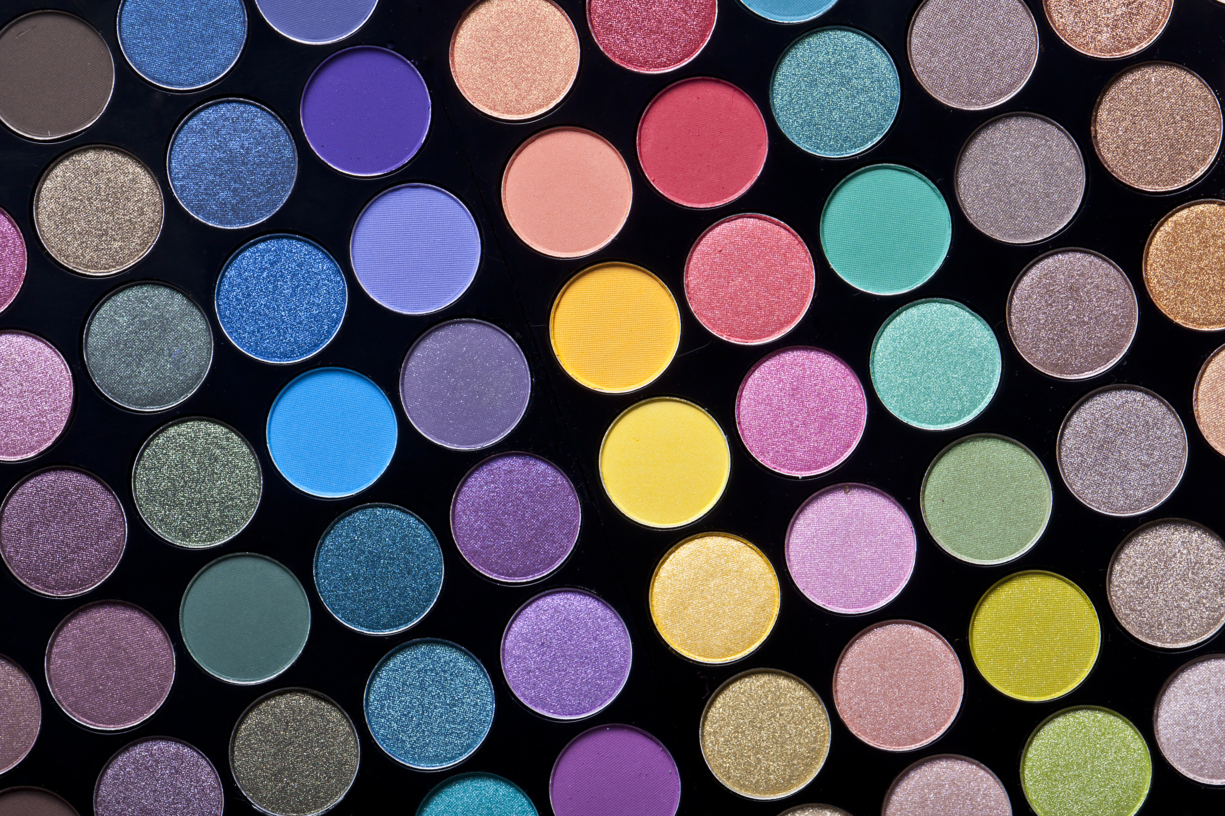
Take ACTION! Do what YOU can to look your best
Get up
Get dressed
Fix your hair
Do your makeup
Buy at least one outfit in a great color that fits you now
Fix what you can fix
Start to exercise
Talk to other survivors
This Photo by Unknown Author is licensed under CC BY-SA

Slide 7
DARCIE ZAUHA
Image Consultant

Slide 8
HELP! I DON’T RECOGNIZE MYSELF!
In the Treatment Room
Makeup tips and tricks
After Treatment
Ongoing Treatment

Slide 9
DURING TREATMENT
Bring color to the room!

Slide 10
Yellow or Blue Based
Bright or Blended

Slide 11
DURING TREATMENT
Choose your “uniform”
pick a few neutrals (navy, gray, cream, white, deep tans)
pick 3-4 colors that work well with them
mix and match different looks

Slide 12
Have a “signature”

Slide 13
MAKEUP TIPS
Moisturizer (Aveeno Baby Eczema)
SPF
Primer or silicone base with illuminator for a little glow
Lip mask

Slide 14
MAKEUP TIPS
Blush
For brows, use a stencil with a soft, crayon like pencil or a temporary tattoo
Mascara if you can
Tightline eyeliner
Hydrating Lipstick – draws attention to eyes, brightens face, which can often go gray

Slide 15
AFTER TREATMENT
Your new “normal”

Slide 16
ONGOING TREATMENT
Make the most of your time
Take chances
Have fun – Grab life!
Don’t let cancer define who you are

Slide 18
THANK YOU!
www.houseofcolour.com
Darcie Zauha
House of Colour West Omaha
Darcie.Zauha@houseofcolour.com
402.672.1122
www.hocwestomaha.com
Instagram: @HOC_west_omaha
Facebook: House of Colour West Omaha

Slide 19
Resources
https://lookgoodfeelbetter.org/workshops/
(virtual workshops on skin, nail care, makeup and more)
https://everyou.com (catalog of products including head coverings, hair pieces and wigs, and mastectomy bras, camisoles)

